Slide 1
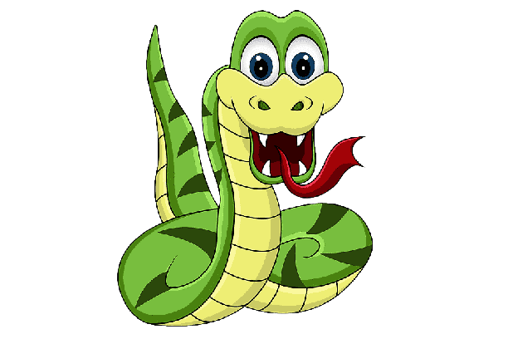
Object Oriented Programming
Snake Game
Muhammad Rafi Hayla Arifa
05111942000014
Nadhif Bhagawanta
05111942000029

Slide 2
Background
Snake is the common name for a video game concept where the player maneuvers a line which grows in length, with the line itself being a primary obstacle. In this game, the player controls a snake. The objective is to eat as many apples as possible. Each time the snake eats an apple its body grows. The snake must avoid the walls and its own body.

Slide 3
Game Improvements
1. The Snake can go through borders now
2. There is an added “Bomb” for the game that causes an instant game over
3. Besides using arrow keys to move in the game, the WASD button can be used too.
4. Can reset the Score along with the snake by pressing the “R” key in game.
5. After the game is over(game over screen), we can restart the game by pressing the “Spacebar” Key
6. We can pause the game by pressing the “Escape” key
7. We can resume the game by pressing the “Enter” key.
8. We also input the music to entertain the players

Slide 4
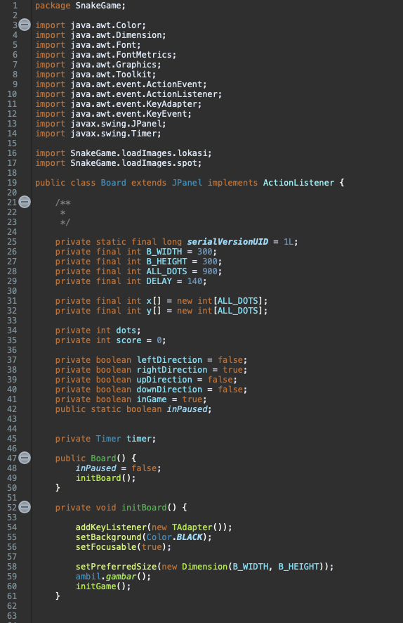
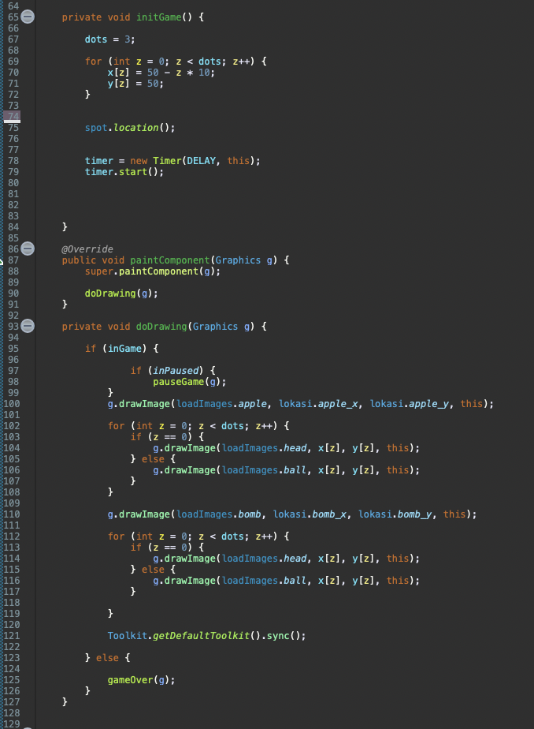
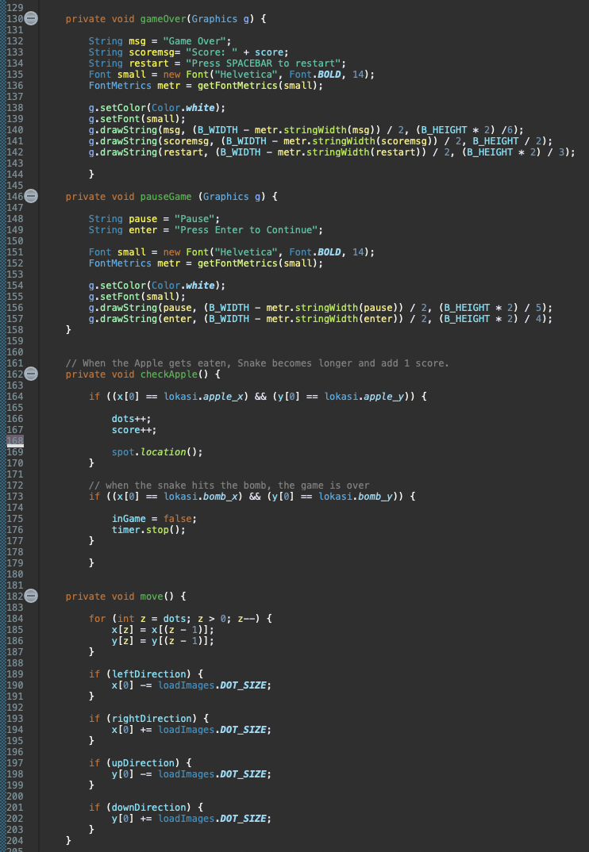
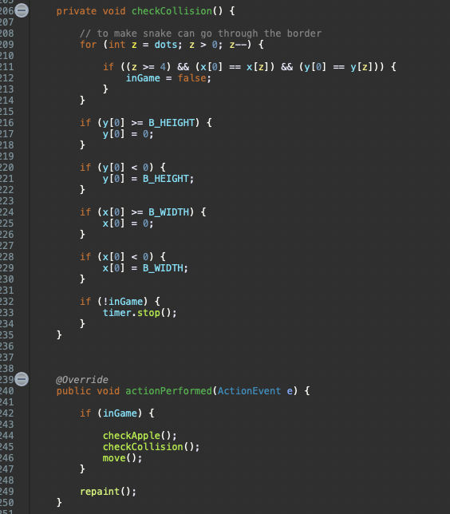
Code
Code for the Board.Java

Slide 5
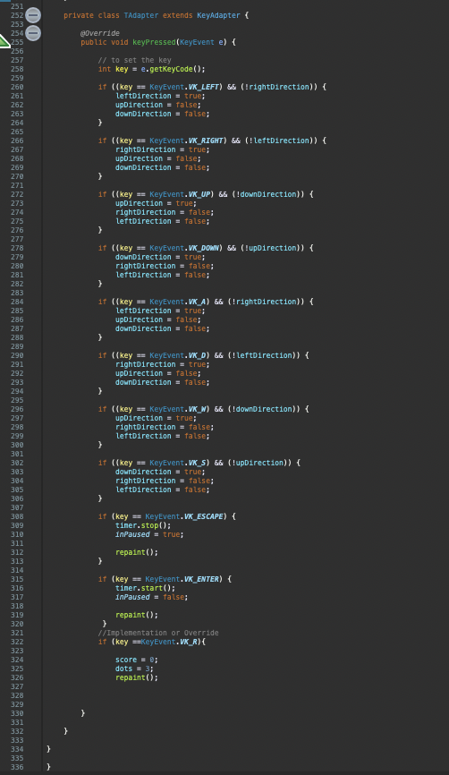
Code
Code for the Board.Java

Slide 6
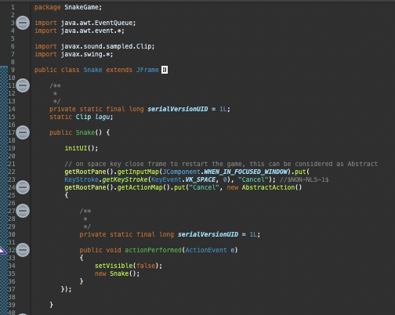
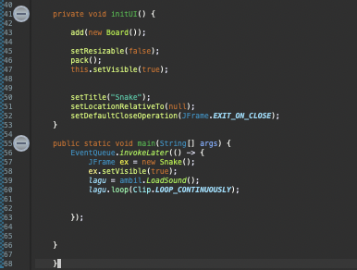
Code
Code for the Snake.Java

Slide 7
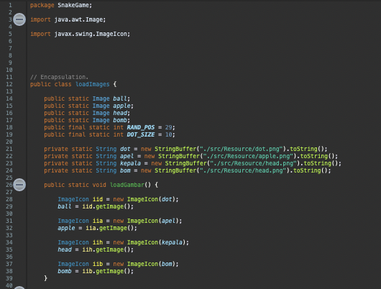
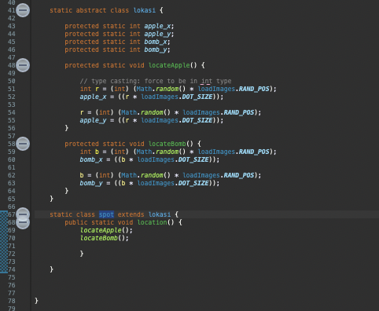
Code
Code for the loadImages.Java

Slide 8
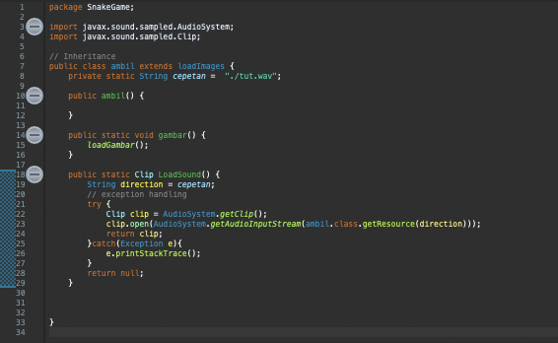
Code
Code for the ambil.Java

Slide 9

Object Orientation Innovation
Override

Slide 10
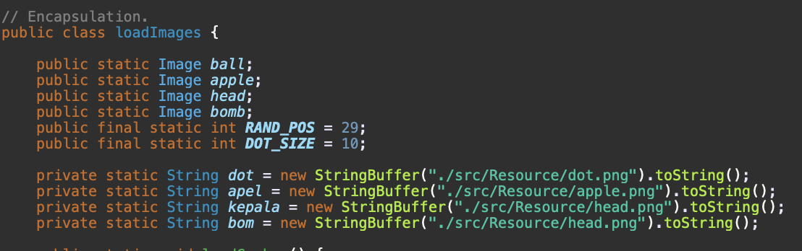
Object Orientation Innovation
Encapsulation

Slide 11
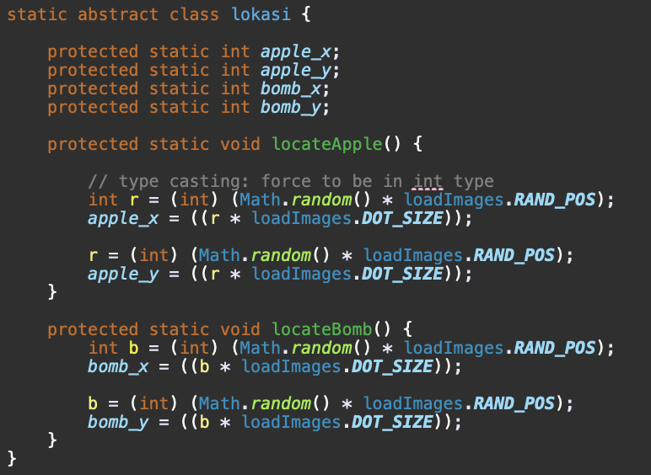
Object Orientation Innovation
Abstract

Slide 12
Object Orientation Innovation
Type Casting

Slide 13
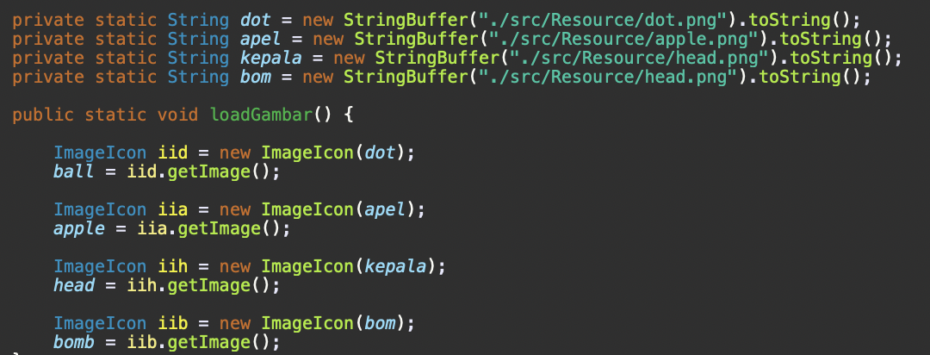
Object Orientation Innovation
String Buffer

Slide 14
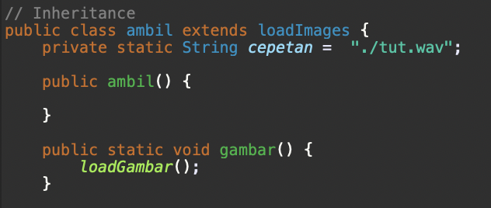
Object Orientation Innovation
Inheritance

Slide 15
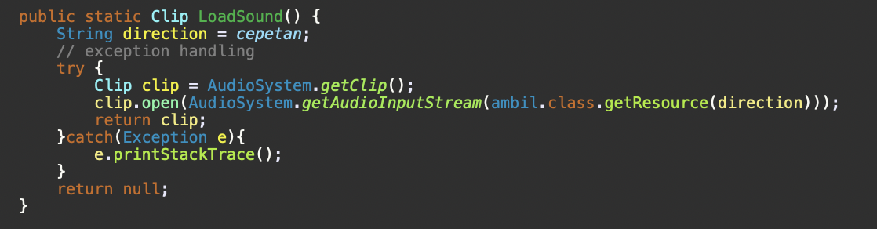
Object Orientation Innovation
Exception-Handling

Slide 16
Conclusion
It can be concluded that our Snake Game has multiple innovations that enhances the game’s experience and along that with innovations such as Encapsulation to load the image for the snake’s components, Abstraction as a way to restart the game without running the code again, Inheritance used to extend the loadImages code from the Java Class and Override to change the use of the Key Presses in game to suit the needs for the Snake Game.

Slide 17
Question?

